Slide 2
Componentize!
Stop fiddling with existing classes.

Slide 3
Who am I?
<Insert Photo Here>
Lance Kind
Agile Coaching since 2006
Developer and author
Working in XP environments since 1999
TDD/Refactoring fanatic
LancerKind@gmail.com
Twitter: @LancerKind, WeChat/微信: LancerKind1234
+01 208 964 0837
Notes:
Instructor Notes:
Please customize this slide prior to the course
Provide a current head shot, your name, any credentials that you would like to include as well as a fun fact about yourself

Slide 4

Some of my work experience

Slide 5
Build a new app, feature by feature (30 minutes)
Review code to see how it’s growing (15 minutes)
Discuss characteristics of componentization (30 minutes)
Refactor (30 minutes)
What to study to learn more

Slide 6

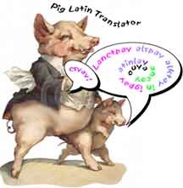
English to Pig Latin Translator
hello -> ellohay

Slide 7
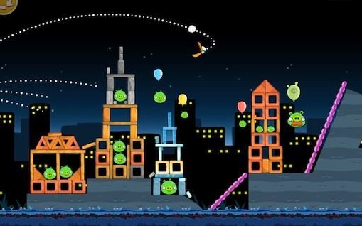
The Job
GameFun is building a virtual world called Pigtopolis where users log on and communicate using Pig Latin.

Slide 8
Not everyone speaks Pig Latin well, so users need a software tool to help them interact until they get good at Pig Latin.
Story: As a game player, I need a Pig Latin Translator so the pigs can understand me when I speak to them.

Slide 9
Story: Simple Pig Latin
As a player, I express myself with partially fluent words so I can ask simple questions.
Acceptance criteria:
can -> ancay
you -> ouyay
help -> elphay
me -> emay
Handle any lower case word.
High quality and maintainable code!

Slide 10
Story: Vowels
As a player, I speak words that start with vowels so my fluency increases.
Vowels: AEIOU (ignore Y for now).
Acceptance criteria:
i-> iay
ate -> ateay
an -> anay
apple -> appleay
Handle any lower case word that start with a vowel.
High quality and maintainable code!
Example: translator.translate(“i”); -> “iay”

Slide 11
Story: QU cluster
As a player, I confuse pigs when I say words that start with QU. Q is a consonant which is always clustered with U, so when moving Q, always move the following U so the pigs understand me.
Acceptance criteria:
quit-> itquay
quarreling -> arrelingquay
Example: translator.translate(“quit”);

Slide 12
Code Review!
How does translate(..) look?
How many lines?
How many condition branches?
Any private functions?
How is translate going to change next iteration? When we add Consonent Cluster,Y Vowel,...

Slide 13
Characteristics of Compentization
Adding new functionality doesn’t require changing old code
Low complexity within components
Zero to few condition branches
Few lines of code
Scope of variables is small
What products are YOU using where you rely on components?

Slide 14
Implementation Details
Use interfaces - method names and arguments are fixed at design time
Or use annotations - method names and arguments are discovered during execution
Discover Components via Reflection or a Dependency Injection library.

Slide 15
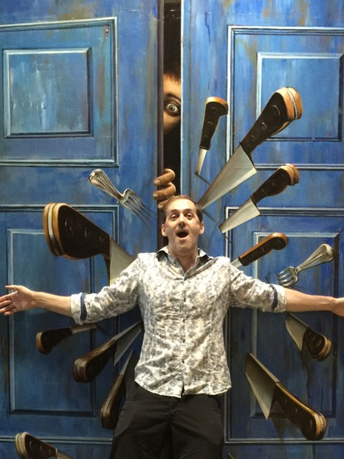
Let’s refactor to components
Currently we have three major features:
words starting with vowels
‘qu’ cluster
simple translation
You have evidence (this is not a YAGNI) that you’ve got a house of horrors. It will only get scarier over time.
There will be more features in the future.

Slide 16

Summary
Switch statements are rarely a good idea
Use static code analysis to find, plan, and exterminate the spooks
Use your business feature requests to analyze for componentization
Your ghostbusters:
Componentize with polymorphic design (interfaces and delegates)
Component Discovery via: Reflection, Annotations, Class Loading
Protocols (Swift)

Slide 17
Don't let monsters grow
Switch statements
If(…) { …} else if(…){…}…
enums

Slide 18
Where to learn more:
Martin Fowler’s Refactoring chapter 9, Replace Conditional with Polymorphism
Kent Beck’s Implementation Patterns Chapter 5, Delegation
Robert Martin’s Dependency Inversion Principle (Web search the white paper)

Slide 19
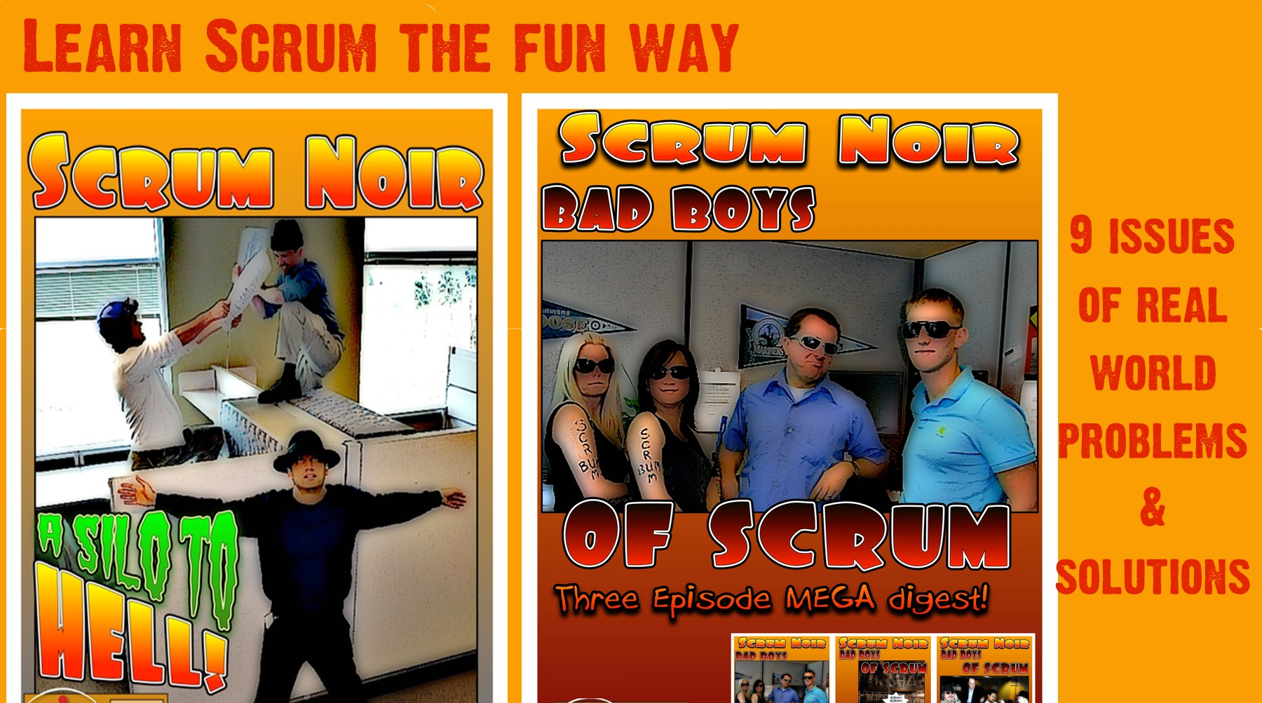

Hope you learned how to stop design entropy
Available on pothi.com, flipkart, and Amazon

